Slide 1


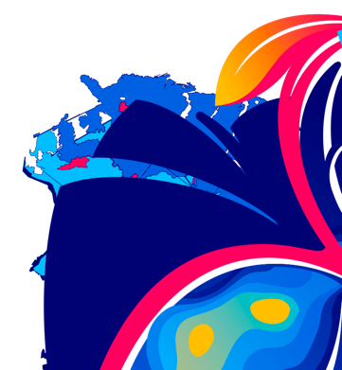
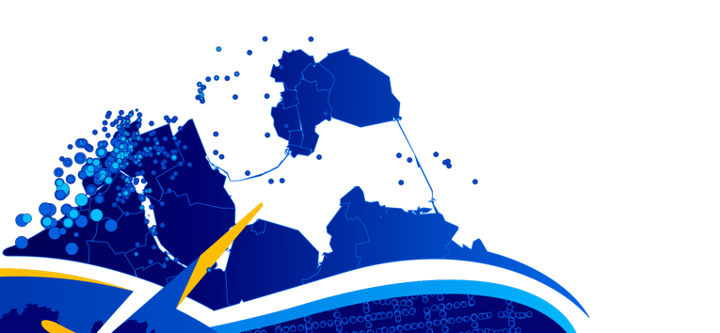



ArcGIS API for JavaScript: Dynamic Vector Symbology
Anne Fitz, Kristian Ekenes, and Russell Roberts
https://arcg.is/1STzGK0
2021 ESRI DEVELOPER SUMMIT
Notes:
Thank you for joining us this year for our virtual Developer Summit! My name is Anne Fitz and I’m a product engineer on the ArcGIS API for JavaScript. I’m here with two of my colleagues – Kristian Ekenes, who is also a Product Engineer on the JSAPI and Russ Roberts, who is a PE for ArcGIS Online. Today we’re going to talk to you about Dynamic Vector Symbology, and how you can use it in the JavaScript API. All the slides and demos for this presentation will be available at the link here – arcg.is/1STzGK0

Slide 2
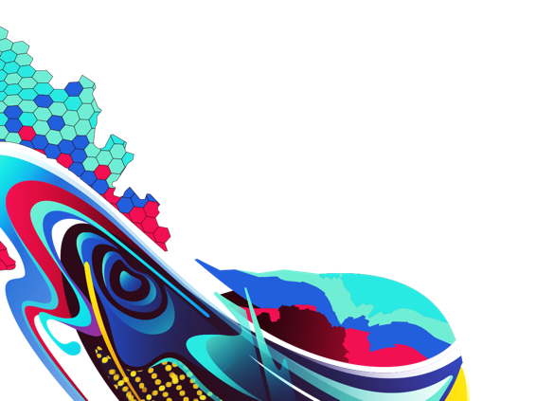
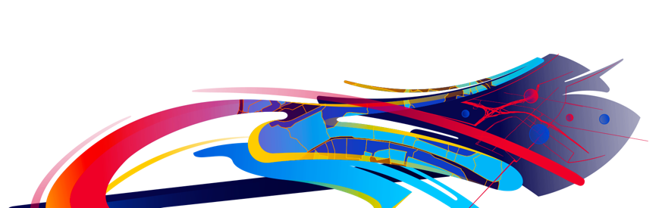
Agenda
What are CIM Symbols?
Create a symbol from scratch
Creating a web style
Data-driven CIM
Notes:
So first I’ll just briefly go over the agenda for today’s session. We’ll start by talking about CIM Symbols, and how to create these symbols from scratch. Then I’ll pass it off to russ who will talk to us about creating a web style, and how you can use those symbols in your apps. And finally, Kristian will talk to us about how you can use your data to drive your CIM symbols.

Slide 3


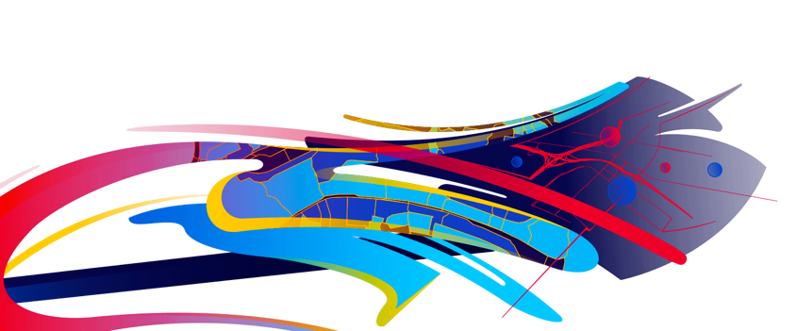
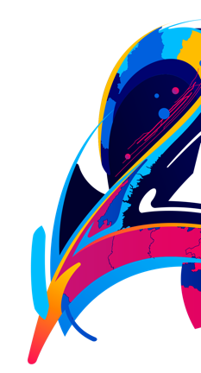
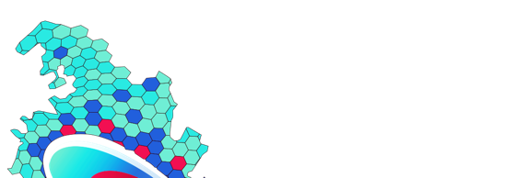


What are CIM Symbols?
Anne Fitz
Notes:
Alright so first – what are CIM symbols? You might have heard of CIM before – it stands for the Cartographic Information Model, and under the hood it’s what we’ve used to define symbols in ArcGIS Pro for a while now. We brought support for CIM point symbols to the JavaScript API at version 4.12, and support for CIM lines and polygons at version 4.16.

Slide 4
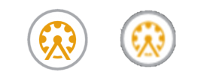




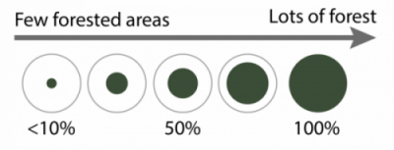
CIM Symbols
High quality, scalable
Symbol layers
Symbol
layer1
layer2
layer3
Scaled vector symbol
Scaled image
Primitive Overrides
Dynamically update attributes of an individual symbol layer using Arcade
Notes:
So you might have some initial questions about CIM symbols – why should I use these symbols over the other symbols provided in the API? What makes these symbols unique?
Well, in a lot of situations – the other symbols in the API might work well for you, if you need just a simple point line or polygon symbol, then I recommend using those symbols that are provided out of the box in the API.
But, if you are looking for a symbol that you can completely customize to your liking – then the CIMsymbol is what you’re looking for. CIM symbols are high quality vector symbols that look good at any scale – for example see this image comparing a scaled vector symbol to a scaled image. The vector symbol will look crisp even at high zoom levels.
Probably the most important feature of the CIM symbol is its symbol layers – Symbol layers are the building blocks of CIM symbols – and they combine to make rich graphical depictions. You can configure the shape, color, texture, size, position, etc of each symbol layer, and then combine these symbol layers to create your desired symbol. For example we can see the symbol here is a kind of globe – shape with a number on it – if we break it down, it has three symbol layers, one layer for the number text, one for the blue circle, and one for the small gray marker at the bottom of the symbol. Each of these symbol layers has unique properties set on it to define what it looks like and where it’s placed in the final symbol, giving users total control over what their symbol will look like.
Finally, the last thing I want to mention is primitive overrides. This is a property on the CIMSymbol that allows you to dynamically update the attribute of an individual symbol layer using Arcade – So for example, in this image here you can see that the size green inner circle increases as the amount of forested area increases, but the outer gray circle remains the same. This is the magic of primitive overrides – you can be very very specific in how you want your symbol to look based on your data. Kristian will talk to us about this more later.

Slide 5
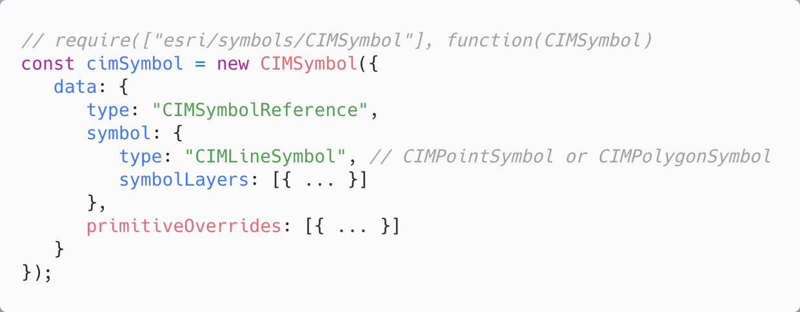
How is it used in the ArcGIS API for JavaScript?
follows the cim-spec
Notes:
Ok, so now that we’ve talked about all the things that make CIMSymbol great – the next question you might have is how can I get started?? How can I use this in the API?
So CIMSymbol is a symbol class – any place that we support using symbols in the API (like for a graphic or rendering a layer) its fair game to use the CIMSymbol. Creating a CIMSymbol is a bit different than other symbols though, there’s just one main property that you should use to define your symbol – the data property. CIMSymbols are based on the type CIMSymbolReference in the cim-spec, and are written in JSON. The cim-spec should be your go-to guide when creating CIMSymbols, it has all the information you need and conveniently links to the different properties you’ll need to create your symbol.
So back to the slides – the data.type will always be CIMSymbolReference, and then the symbol property will be where you define your symbol – in this case we’re looking at a CIMLineSymbol, and you will also define your symbolLayers here. Lastly, you can set the primitiveOverrides we mentioned here.

Slide 6
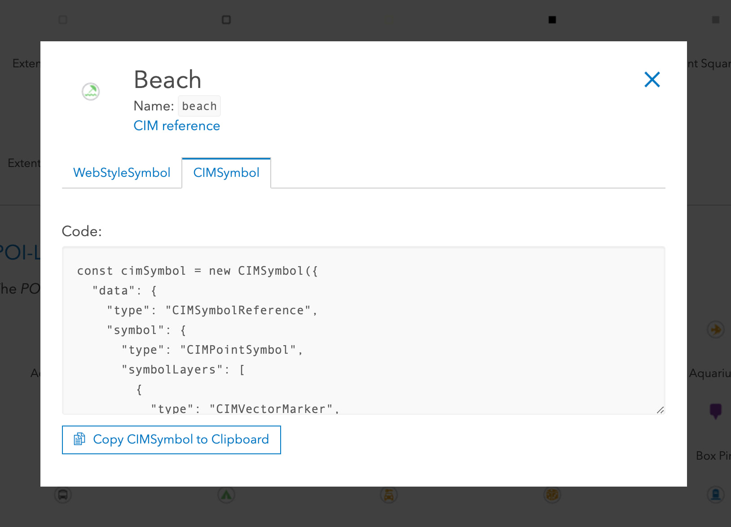
WebStyleSymbols
Predefined 2D CIM symbols that you can conveniently reference in your apps
Esri WebStyleSymbols (2D) guide page
Create your own web style symbols
Notes:
The other way you can use CIM Symbols in our API is through WebStyleSymbols. Web style symbols are predefined 2D CIM symbols that you can conveniently reference in your apps – let’s take a look at the guide page in our documentation. So these are the symbols we provide out of the box. To use one these symbols in your app – you have two options, you can either use a WebStyleSymbol (which you can easily just copy and paste this short snippet into your code) or use a CIMSymbol – which has a much longer snippet, but if you wanted to edit the property at all (change the size or color ) you would need to use this option. Comparing these two snippets you can see how useful a webstyle can be in saving time creating these symbols.
You can also create your own web style symbols and publish them for use in your apps – this is something that Russ will tell us more about later in the presentation.

Slide 7



CIMPointSymbol
CIMPictureMarker
CIMVectorMarker
CIMTextSymbol
Created from raster image file
Represents vector graphics
Constructed from MarkerGraphics
Supported as a marker graphic on a CIMVectorMarker symbol layer
Notes:
So to show you all that’s possible with CIMSymbols – I thought it would be best to go through each symbol type and talk about the symbol Layers that are supported on that type. Then to create your symbol, you can use any combination of the symbol layers that I mention here. Let’s start with CIMPoint Symbol – there are three main things we want to point out here, the first is the CIMPictureMarker symbol layer. This is created from a raster image file, and allows you to bring images into your symbol, like I did with this esri logo here.
Next, we have the CIMVectorMarker symbol layer – which represents vector graphics. It’s constructed from a collection of MarkerGraphics, which are the geometries and symbols that are used as building blocks for the marker. So for this symbol shown here, this would actually be comprised of two CIMVectorMarker symbol layers – one for the blue pin and one for the gray base. Then that blue pin symbol is constructed of two different marker graphics – one creating the pin and one cutting out the whole in the center.
Lastly, though this is not a symbol layer on its own, I wanted to point out that you can add text to your symbols through the CIMTextSymbol. This is supported as a marker graphic on the CIMVectorMarker Symbol layer.

Slide 8
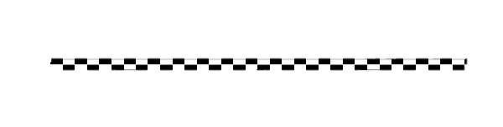
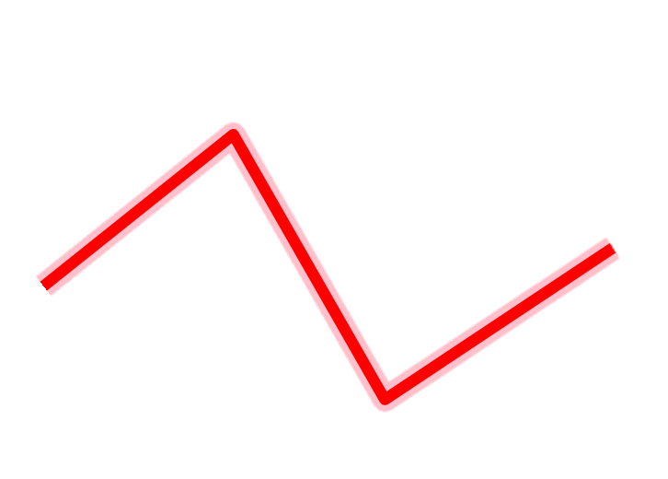
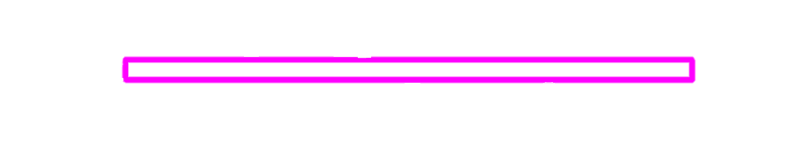
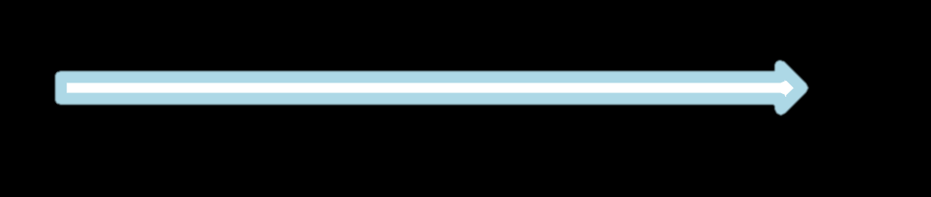
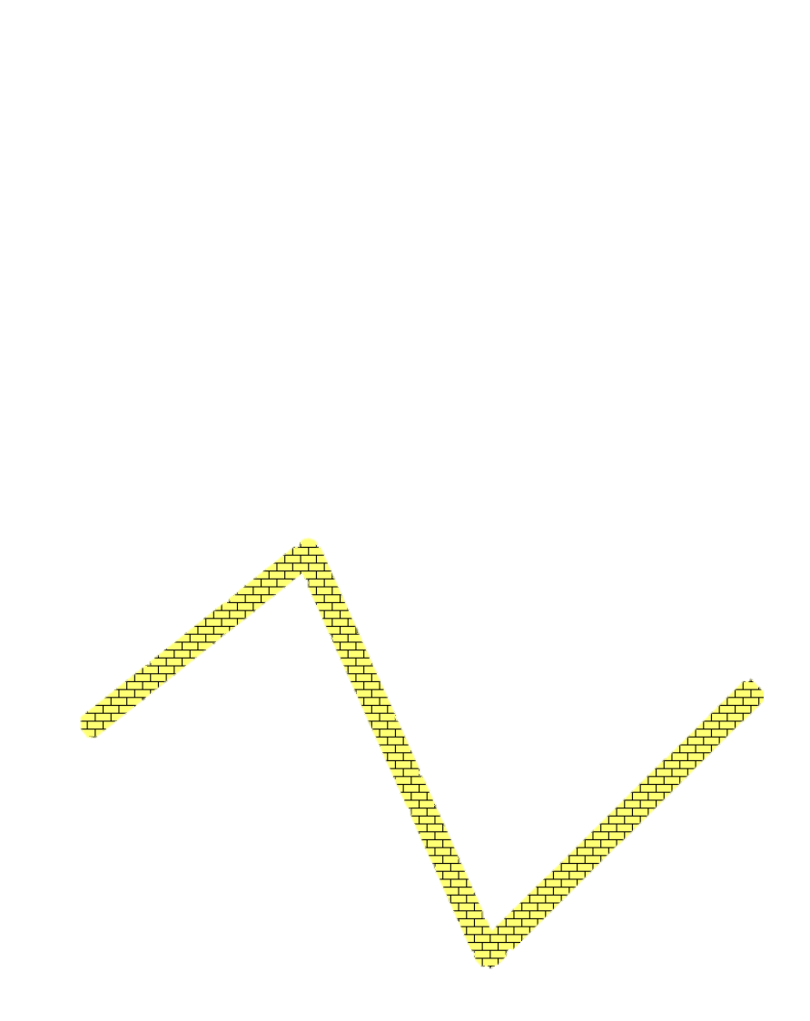

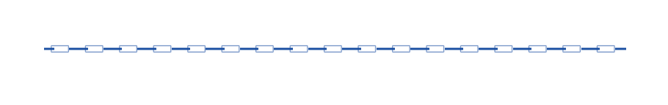
CIMLineSymbol
Geometric Effects
Dashes
Buffer
Arrows
Marker placement
CIMSolidStroke
CIMPictureStroke
Notes:
Next – lets talk about line symbols. So there are two symbol layers that can be used here CIMSolidStroke, which is exactly what it sounds like, just a solid stroke of a line, and CIMPicture stroke – where you can create a line from a picture file. I know the CIMSolidStroke might not seem like much at first glance, but you can layer strokes on top of each other to create unique symbols, like I did with this cased line symbol.
You can also apply geometric effects to these symbol layers and have total control over how these effects are displayed. You can apply dashes to your line, like we do in this symbol. And with the dash geometric effect, you can specify the dash pattern you want, how long the dashes should be, etc - and in this specific example, we’re also using the offset geometric effect to place two sets of dashed lines next to each other. I’ll inclue the CIM JSON for each of these symbols in the Github repo mentioned at the beginning of the session. There are many other geometric effects that we support that allow you to create awesome visualizations – like with the buffer or arrows effects shown here. There are more we support, you’ll have to check out the cim-spec for more info on those.
Lastly, CIMLineSymbols support a marker placement property, where you can add one of the Marker symbol layers we mentioned in the last slide, and use it to create the line (like with this line created from star markers) or place the markers along the line (like with this blue line with small rectangles.

Slide 9
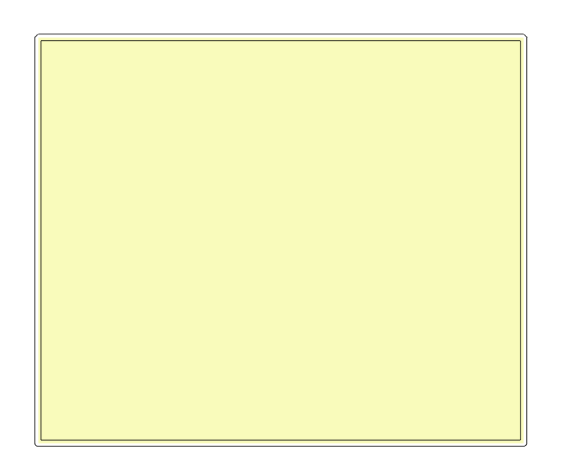
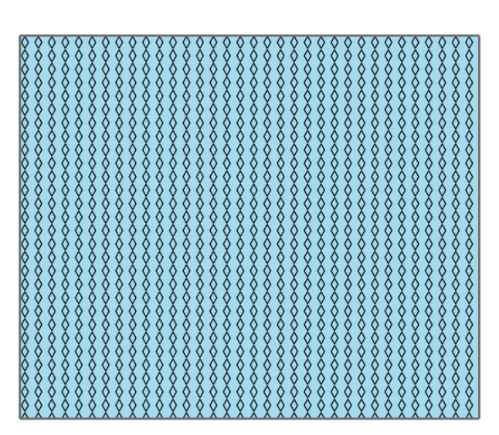
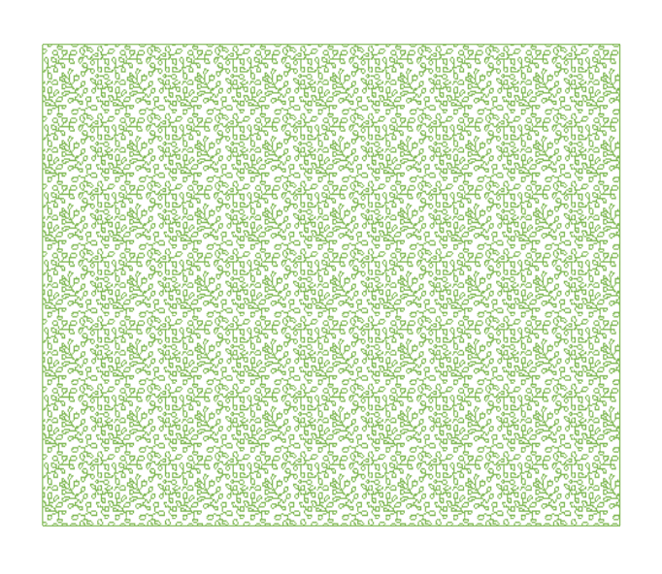
CIMPolygonSymbol
CIMSolidFill
CIMHatchFill
CIMPictureFill
Notes:
Lastly, polygon symbols. There are three supported fill symbol layers that you can use on your polygon symbol – CIMSolid Fill, which just fills the polygon with a solid color, CIM hatch fill, which uses a series of parallel line symbols to create a hatched effect in the symbol, and CIM picture fill, which uses an image to fill the symbol. The cool that you can use everything you’ve learned about so far on these polygon symbols - you can use the line symbols for the polygon outline, or to create unique lines to use for the HatchFill, and you can also use vector markers and use the markerPlacement property to place those marker symbols throughout your polygon.

Slide 10
Create a symbol from scratch
Anne Fitz
Notes:
Ok, so now that I’ve given you a pretty in depth explanation of what CIM symbols are, how to use them in the JSAPI and what symbol layers are available to you – lets go ahead and create a CIMSymbol from scratch and add it to our app.

Slide 11
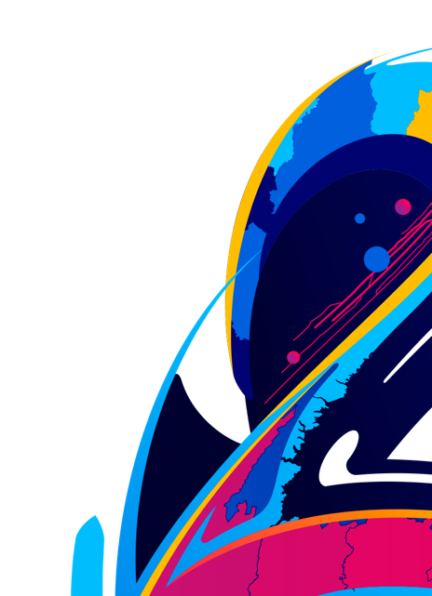
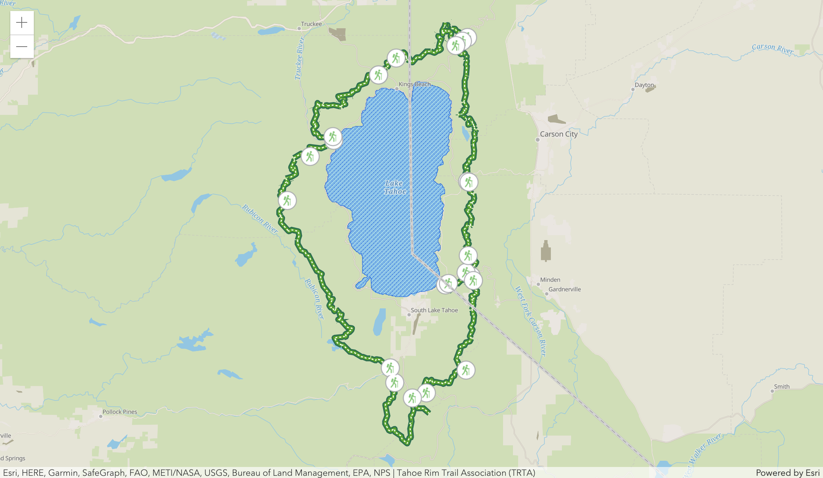
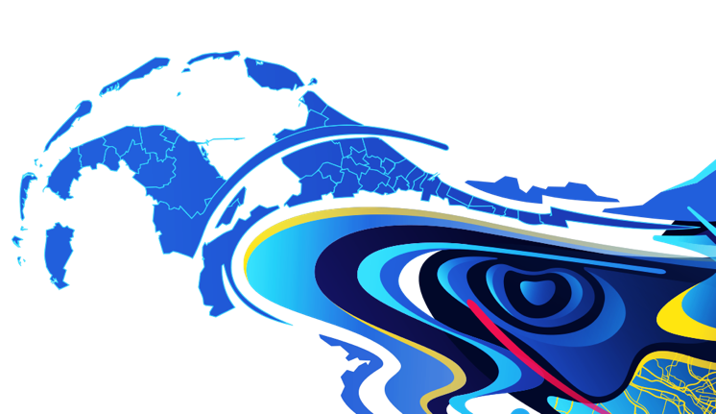

CIM Starter App
Anne Fitz
Notes:
Note to self: Use typescript here – show off how helpful the typings are when writing with CIM

Slide 12
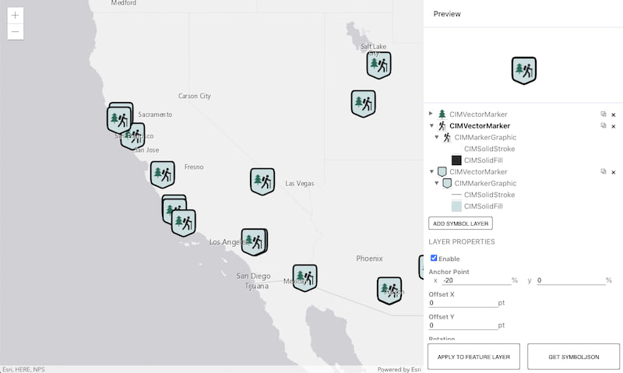
CIM Symbol Builder

Slide 13
Creating a Web Style
Russell Roberts

Slide 14
How to create a Web Style
Share web styles with ArcGIS Pro 2.6 and up
Currently only points supported
For 2D Web Styles publish picture or shape marker
Vector symbols can be .svg or .emf format with shape marker
Use them in web maps and 4.x web apps, runtime 100.x apps and Pro.
Map Viewer Beta, Experience Builder, Dashboard Beta and more

Slide 15
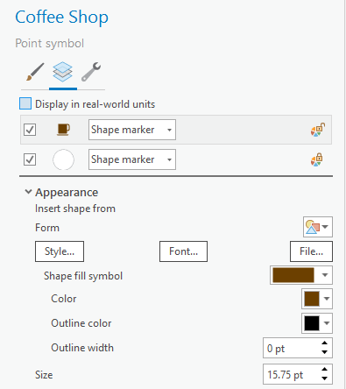
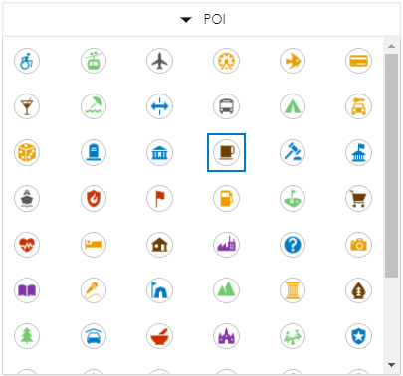
Creating a WebStyle
Russell Roberts

Slide 16
Data-driven CIM
Kristian Ekenes

Slide 17
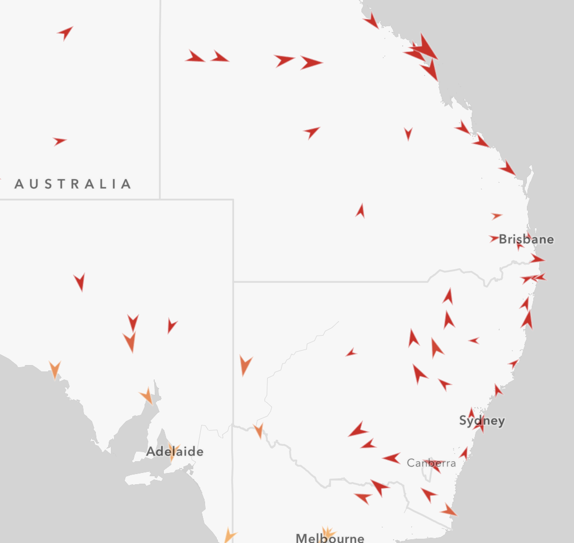
Data-driven mapping
Override a symbol’s visual variable with a data value (either a field value, or an Arcade expression).
opacity
rotation
size
color

Slide 18
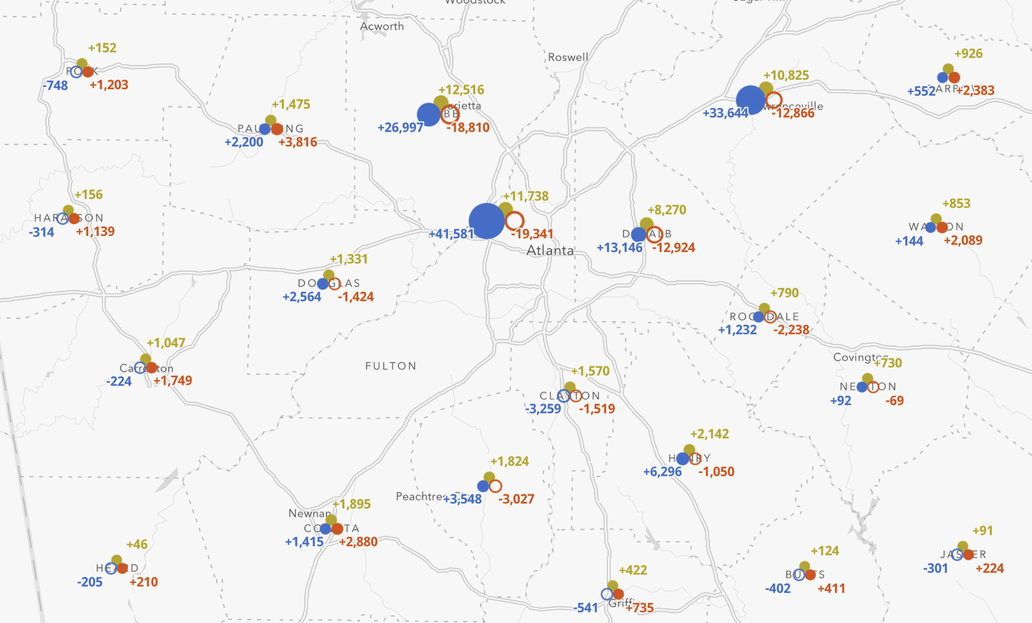
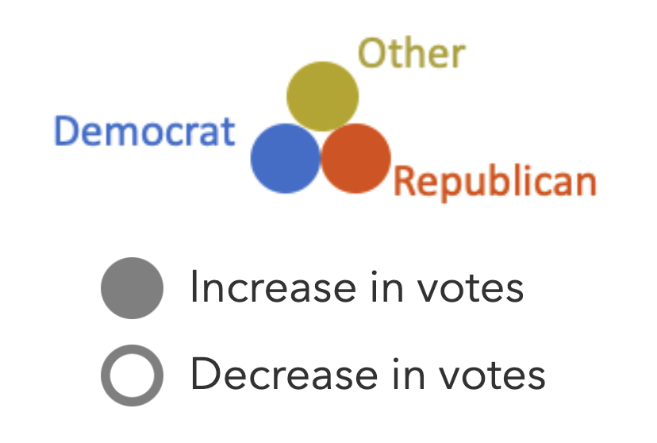
Multi-part data-driven symbols
Multiple symbol layers.
The visual properties of each can be controlled by data values, so you can create more complex, multi-part, data-driven visualizations.
More complex usually isn’t a good thing, but it can be!

Slide 19
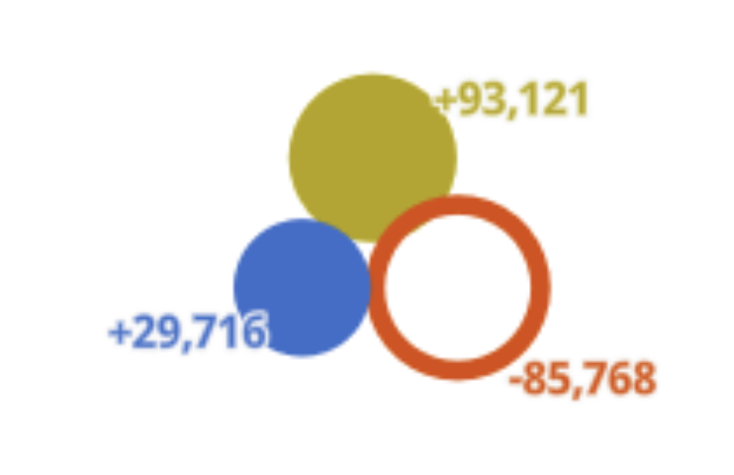
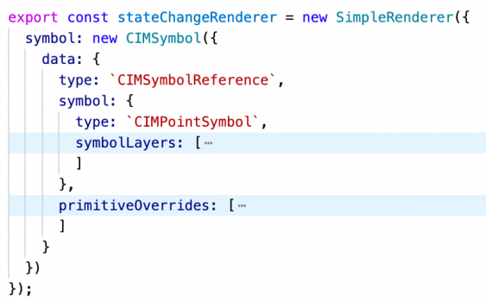
Primitive Overrides
A property of CIMSymbol.
Arcade expressions that dynamically return the value of a primitive’s visual property.
e.g. a primitive override targeting size returns a new size value for a targeted symbol layer (primitive).
Typically used to change a symbol property based on a data value or expression.

Slide 20
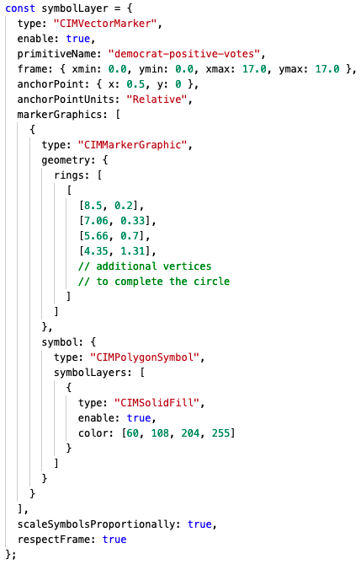
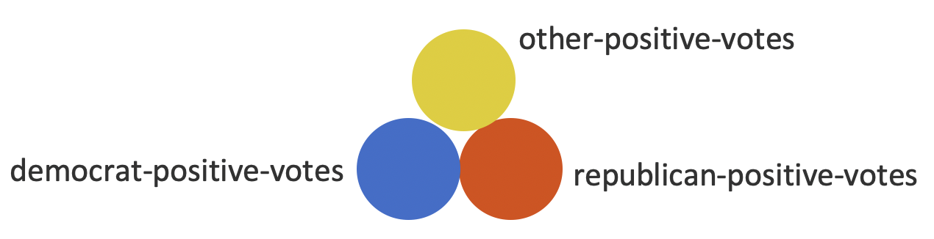
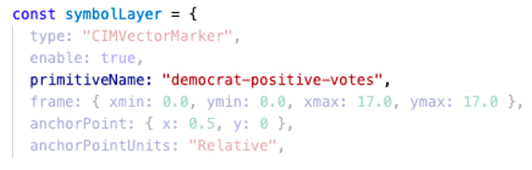
Primitive Overrides

Slide 21
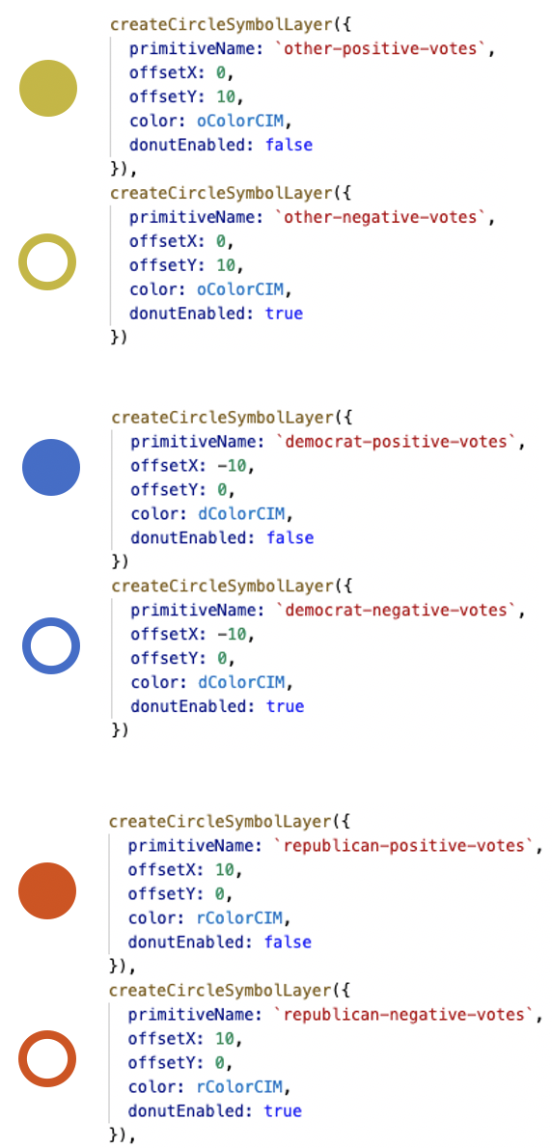
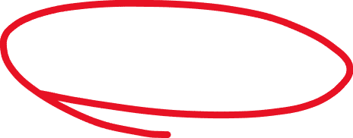
Primitive Overrides

Slide 22
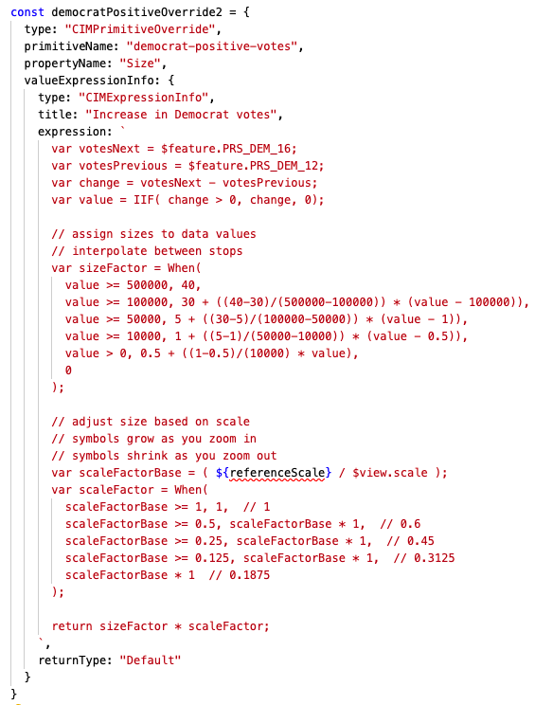
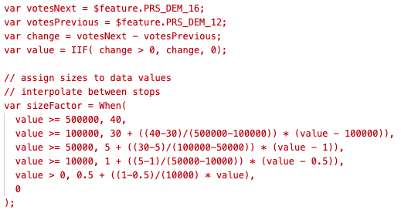
Primitive Overrides

Slide 23
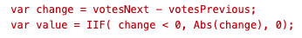
Primitive Overrides
Computed sizes
10.82
3.97
10.36
All other symbol layers are assigned a size of zero, and therefore aren’t drawn.

Slide 24
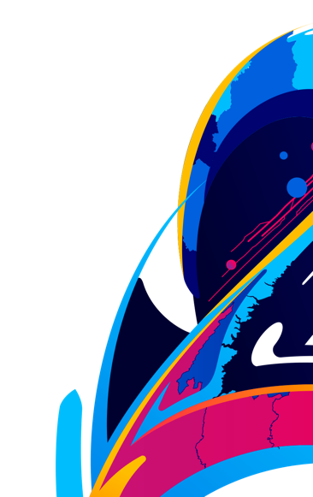
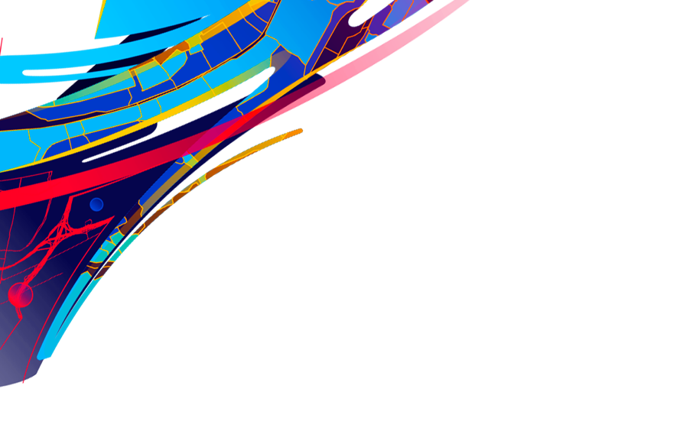
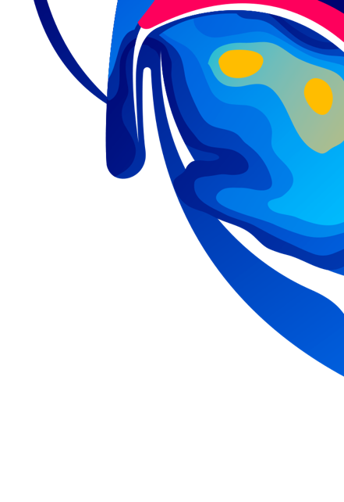

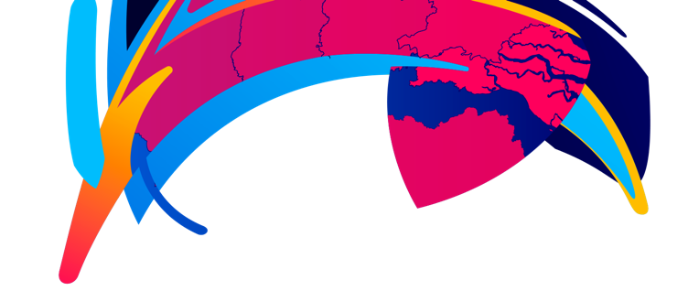

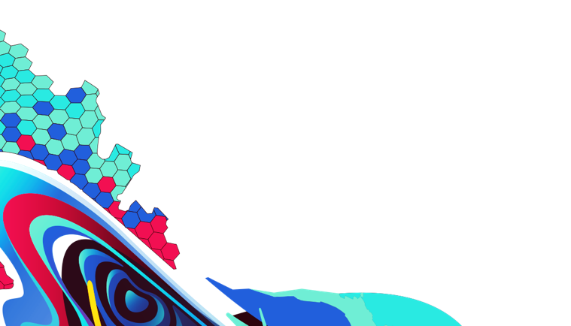
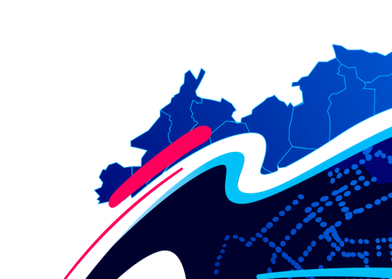
Please provide your feedback for this session by clicking on the session survey link directly below the video.

Slide 25

Copyright © 2021 Esri. All rights reserved.

